Slide 1
CITY OF RALEIGH PUBLIC UTILITIES DEPARTMENT
STRESS MANAGEMENT MODULE
Notes:
https://www.olympiabenefits.com/blog/the-best-tools-for-stress-management-in-the-workplace-resource-list

Slide 2
Training Goals
By the end of this module, you will be able to:
Develop tools to navigate internal stressors
Manage external stressors
Develop a plan for reducing stress associated with organizational change

Slide 3
This module is composed of two parts:
Part I. Background information on stress
What is stress?
What causes stress at work?
Symptoms of stress
Assessing your internal stress
Techniques for managing external stress
Action Planning to Reduce Work Stress
Part II. Techniques for Stress Management
Notes:
Techniques for Stress Management

Slide 4
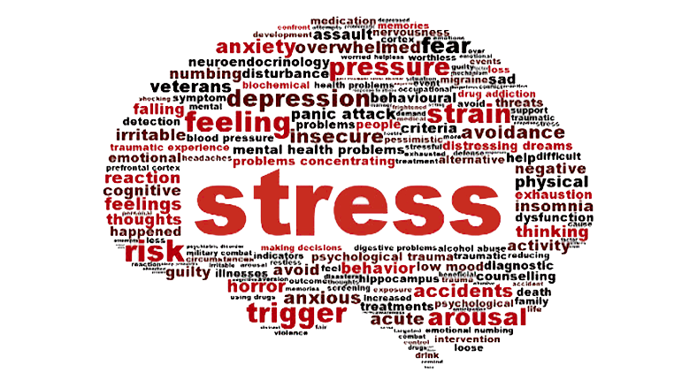
Part I - Background Information on Stress
What is stress?
What causes stress at work?
Symptoms of stress
Notes:
https://www.graphic.com.gh/lifestyle/life/managing-stress-after-the-festive-season.html

Slide 5
What is Stress?
Have any of these situations happened to you?
Someone cut you off in traffic
You missed an important phone call
Your home life is difficult
You were late for a deadline
You were suffering from health issues
Notes:
Stress can happen to anyone at anytime. This slide provides common examples that employees might be experiencing at any given moment. What other situations do you find to be stressful?

Slide 6
What is Stress?
There are three main types of stress:
Acute
Episodic Acute
Chronic
Notes:
Hover over each phrase for the definition:
Acute stress can be described as a moment of crisis. For example, acute stress can be experienced when you are driving, and your heart starts racing after avoiding a collision.
Episodic acute stress can be described as having multiple moments of crisis over time. For example, having a supervisor who constantly assigns last minute projects can be an example on episodic acute stress.
Chronic stress is stress that lasts for a long time. Examples of chronic stress tend to be over the course of months or years, like having to live paycheck to paycheck or having a long term illness.
To read more about the three main types of stress, select the following link: https://www.psychologytoday.com/us/blog/open-gently/201812/the-three-types-stress.

Slide 7
2. What Causes Stress at Work?
Job Demands vs. Job Resources
Work related conditions that contribute to stress can be categorized under job demands or job resources (Na, Choo, & Klingfuss, 2018). The structural or systematic mismatch of these conditions are considered the cause of job-related stress.

Slide 8
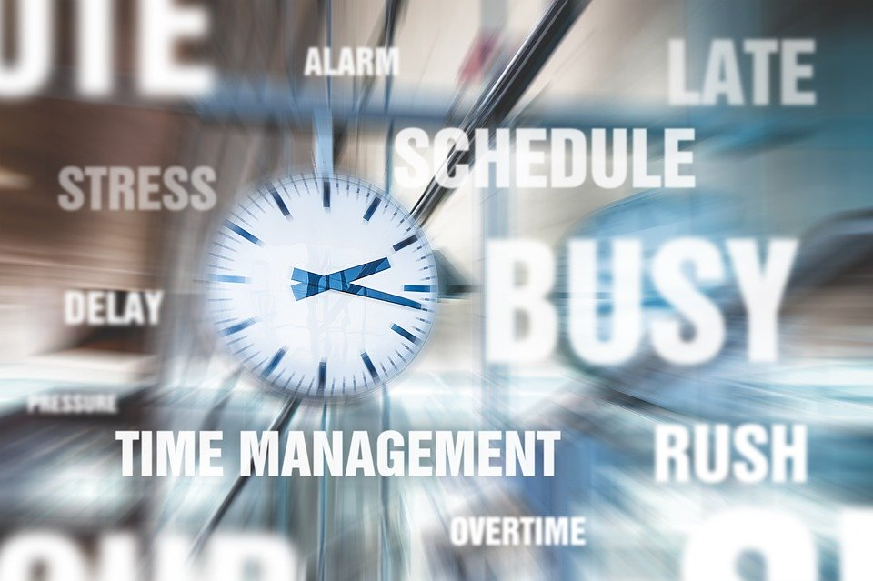
2. Sources of Stress at Work
Five Sources of Stress at Work
1.Innate to Job
2.Role in Organization
3.Career Development
4.Relationship at Work
5.Organizational Structure
Notes:
The workplace is a source of both demands and pressures causing stress and the structural and social resources to counter stress (Michie, 2002). The above outlined categories of factors associated with stress and health risks with he first two associated with the content of work and the last three with the social and organizational context of work (Michie, 2002).

Slide 9
2. Sources of Stress at Work
Innate to the Job
Poor physical working conditions
Work overload
Time pressure
Physical danger, etc.
Notes:
Those factors intrinsic to the job include working long hours, work overload, time pressure, difficulty of tasks, lack of breaks, and poor physical working conditions (Michie, 2002).

Slide 10
2. Sources of Stress at Work
Role in Organization
Role ambiguity
Role conflict
Responsibility for others
Conflicting roles and boundaries
Notes:
Unclear or conflicting roles and boundaries along can prove to be a major cause of stress (Michie, 2002). Likewise being responsible for other can be a cause of stress (Michie, 2002).

Slide 11
2. Sources of Stress at Work
Career Development
Over promotion
Under promotion
Lack of job security
Inhibited ambition
Notes:
Career development is a key defense for lack of training, under/over promotion, and job security (Michie, 2002).

Slide 12
2. Sources of Stress at Work
Relationship at Work
Poor relationship with supervisor, employees, or co-workers
Difficulties in delegating responsibilities
Lack of trust
Notes:
Supervisors and co-workers who are critical, demanding, and unsupportive can cause great stress, while positive social interaction and good teamwork reduces stress (Michie, 2002).

Slide 13
2. Sources of Stress at Work
Organizational Structure and Climate
Little or no participation in decisions
Restrictions on behavior
Office politics
Lack of effective consultation
Financial difficulties
Notes:
Organizational change without adequate consultation with employees, paired with a culture of not informing or involving people on organizational decisions can be extremely stressful (Michie, 2002).

Slide 14
3. Symptoms of Stress
Stress without relief leads to distress
People handle stress differently, which means that the symptoms of stress can vary
Symptoms of stress can also be signs of other health problems
Knowing your stress symptoms can help prevent stress and help you to handle it more effectively
The Occupational Safety and Health Administration (OSHA) declared stress a hazard of the workplace.
Notes:
Robinson, J. (2017). The Effects of Stress on Your Body. Retrieved from https://www.webmd.com/balance/stress-management/effects-of-stress-on-your-body.
Casarella, J. (2019). Stress Symptoms: Physical Effects of Stress on the Body. Retrieved from https://www.webmd.com/balance/stress-management/stress-symptoms-effects_of-stress-on-the-body#2.

Slide 15
3. Symptoms of Stress
Signs and Symptoms of Stress
Physical
Emotional
Cognitive
Behavioral
Notes:
There are four main categories of signs and symptoms of stress: physical, emotional, cognitive, and behavioral. These four categories will be described in detail on the following slides.
Casarella, J. (2019). Stress Symptoms: Physical Effects of Stress on the Body. Retrieved from https://www.webmd.com/balance/stress-management/stress-symptoms-effects_of-stress-on-the-body#2.

Slide 16
3. Symptoms of Stress
Physical Signs of Stress
Low energy
Headaches
Digestive issues
(diarrhea, constipation, nausea)
Aches, pains, tense muscles
Chest pain, rapid heartbeat
Insomnia
Frequent colds and infections
Notes:
The physical signs of stress include having a low level of energy, frequent headaches, digestive issues - including diarrhea, constipation, or nausea, aches, pains, tense muscles, chest pain, rapid heartbeat, insomnia, frequent colds and infections.
Casarella, J. (2019). Stress Symptoms: Physical Effects of Stress on the Body. Retrieved from https://www.webmd.com/balance/stress-management/stress-symptoms-effects_of-stress-on-the-body#2.

Slide 17
3. Symptoms of Stress
Emotional Symptoms of Stress
Frustration, agitation
Feeling overwhelmed
Difficulty relaxing
Low self-esteem, worthlessness
Loneliness
Depression
Panic attacks
Notes:
The emotional symptoms of stress include feelings of frustration and agitation, feeling overwhelmed, difficulty relaxing, feelings of low self-esteem and worthlessness, loneliness, and panic attacks.
Casarella, J. (2019). Stress Symptoms: Physical Effects of Stress on the Body. Retrieved from https://www.webmd.com/balance/stress-management/stress-symptoms-effects_of-stress-on-the-body#2.

Slide 18
3. Symptoms of Stress
Cognitive Symptoms of Stress
Constant worrying
Racing thoughts
Forgetfulness and disorganization
Inability to focus
Poor judgement
Negativity
Notes:
The cognitive symptoms of stress include constant worrying, racing thoughts, forgetfulness and disorganization, inability to focus, poor judgement, and negativity.
Casarella, J. (2019). Stress Symptoms: Physical Effects of Stress on the Body. Retrieved from https://www.webmd.com/balance/stress-management/stress-symptoms-effects_of-stress-on-the-body#2.

Slide 19
3. Symptoms of Stress
Behavioral Signs of Stress
Changes in appetite
Procrastination and avoidance of responsibilities
Increased use of alcohol, drugs, or cigarettes
Nervous behaviors
(ex: nail biting, fidgeting, pacing)
Notes:
The behavioral symptoms of stress include changes in appetite, procrastination and avoidance of responsibilities, increased use of alcohol, drugs, or cigarettes, and nervous behaviors - including nail biting, fidgeting, and pacing.
Casarella, J. (2019). Stress Symptoms: Physical Effects of Stress on the Body. Retrieved from https://www.webmd.com/balance/stress-management/stress-symptoms-effects_of-stress-on-the-body#2.

Slide 20
3. Symptoms of Stress
Long-term Effects of Stress
Mental health problems
(ex: depression, anxiety)
Cardiovascular disease
(ex: heart disease, high blood pressure, heart attacks, stroke)
Obesity and eating disorders
Skin and hair problems
(ex: acne, psoriasis, eczema)
Gastrointestinal problems
43%
of all adults suffer adverse health effects from stress.
Notes:
There are also long-term effects of chronic stress that include mental health problems - including depression and anxiety, cardiovascular disease - including heart disease, high blood pressure, heart attacks, and stroke, obesity and eating disorders, skin and hair problems - including acne, psoriasis, and eczema, and gastrointestinal problems. WebMD also notes that 43% of all adults suffer adverse health effects from stress.
Robinson, J. (2017). The Effects of Stress on Your Body. Retrieved from https://www.webmd.com/balance/stress-management/effects-of-stress-on-your-body.
National Institute of Mental Health. (n.d.). 5 Things You Should Know About Stress. Retrieved from https://www.nimh.nih.gov/health/publications/stress/5thingsshldknowaboutstress-508-03132017_142898.pdf.

Slide 21
Stress Management Knowledge Check
Background Information on Stress
What is stress?
What causes stress?
Symptoms of stress
Watch the Video To Review Then Check Your Knowledge
Watch Video #1!
Start Quiz!
Notes:
What is Stress? https://youtu.be/s93ywqFa6CM

Slide 22
Background Information on Stress
Knowledge Check On:
What is stress, what are the causes, what are the signs and symptoms?
Notes:
image from https://www.clipartwiki.com/iclip/xxmRRw_battery-clipart-free-clip-art-stock-illustrations-levels/

Slide 23
Background Information on Stress
What is stress?
A. The way you think, feel and react
concerning things happening
around you
B. Too much stress can be bad for
your health
C. Stress is a normal part of
everyone's life
D. All of the above
Notes:
D. All of the above

Slide 24
Background Information on Stress
2.What are some triggers
for stress at work?
Work conditions
Responsibilities for others
Lack of job security
Relationships with coworkers
All of these can cause stress
Notes:
E. All of these can cause stress

Slide 25
Background Information on Stress
3. How does stress affect the body?
Stress is only in your head and does
not affect the body.
Stress is a response like fight or flight that could help you perform better on difficult tasks.
Stress can causes high blood pressure and diabetes if not managed.
Both B and C are correct
Notes:
D. Both B and C are correct

Slide 26
Background Information on Stress
4. How can I benefit from learning
to manage stress on the job?
A. Cognitive: I can concentrate
better on my job
B. Emotional and Behavioral: It will put
me in a better mood and make work easier
C. Physical: I will have better health and
less sick days
D. All of the above
Notes:
Cognitive: I can concentrate better on my job
Emotional and Behavioral: It will put me in a better mood and make work easier
Physical: I will have better health and less sick days
All of the above

Slide 27
Part II - Techniques for Stress Management
4. Assessing your Stress
5. Techniques for Stress Management
6. Action Planning

Slide 28
4. Assessing Your Stress
Personal inventory/assessment rating personal level of stress
Stress Assessment on WebMD
Click the Link Below and
Press the Orange Button to Get Started
Take Assessment!
Notes:
Stress Assessment on WebMD Press the Orange Button to Get Started
https://www.webmd.com/balance/stress-management/stress-assessment/default.htm

Slide 29
4. Assessing Internal Stressors
Current Stress Management Techniques
What techniques do you currently use to fight stress?
Are those techniques working?
Are there ways you are currently trying to reduce stress?
Keep a journal of techniques that work well for you.

Slide 30
4. Assessing Stressors
Specific Stress Triggers for PUD Employees:
Internal
External
Organizational
Notes:
Use graphics? Hover over term to view definition. Provide example.
https://www.psychologytoday.com/us/blog/what-matters-most/201701/10-new-strategies-stress-management
image from https://www.graphic.com.gh/lifestyle/life/managing-stress-after-the-festive-season.html

Slide 31
4. Assessing Internal Stressors
Managing Internal Stress:
Relaxation strategies
Mindfulness
Meditation
Keep a Cool Head!
Notes:
3 simple strategies to help you focus and de-stress
Do daily distractions leave you feeling unfocused and stressed? Take a breath. Here are three great ways to start taking back control.
By Mayo Clinic Staff
https://www.mayoclinic.org/healthy-lifestyle/stress-management/in-depth/3-simple-strategies-to-help-you-focus-and-de-stress/art-20390057

Slide 32
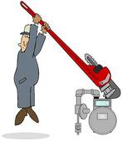
5. Techniques for Managing
External Stressors
Managing External Stress:
Healthy Eating
Exercise
Good Sleeping Habits
Be prepared to tackle the big jobs!
Notes:
There is no single answer for managing stress, but science has discovered some simple steps you can take to limit the effects of stress. The following techniques are just a few that have been found to help. When you start to develop your stress management strategy you may also find new techniques or resources that are beneficial.

Slide 33
5. Techniques for Managing
External Stressors
Healthy Eating and Stress Reduction
The food you eat and drink can have a direct effect on your stress levels.
Vitamin C naturally raises serotonin levels in your brain. Which makes you feel happy! Vitamin C is found in citrus fruit.
Omega 3 Fatty Acids naturally reduce the stress hormone cortisone. It is found in most fish.
Enjoy unhealthy food in moderation.
Notes:
Eating healthy is not only great for your body, but it can drastically alter how you perceive stressors. Inside your brain, a host of chemical interactions dictate the way you view and interact with the world. Supplying your body with the best possible raw materials ensures that your brain functions correctly. Additionally, foods that contain omega 3 fatty acids have been shown to block the production of the stress hormone cortisol. In general, doctors recommend a balanced diet that limits the intake of processed or unhealthy foods. When you eat unhealthy foods regularly, you place physical stress on your body. Physical stress over time can manifest as negative emotional outcomes or behaviors. For more information read the following link.
https://exploreim.ucla.edu/nutrition/eat-right-drink-well-stress-less-stress-reducing-foods-herbal-supplements-and-teas/

Slide 34
5. Techniques for Managing
External Stressors
Benefits of Regular Exercise and Good Sleep
Regular exercise causes your brain to release endorphins, which act as natural painkillers and stress relievers.
Maintaining a healthy lifestyle increases energy levels, and your natural immune system.
Regular exercise improves nightly sleep, which reduces stress.
Notes:
Just as eating healthy benefits your body and mind, exercise also can reduce the effects of stress. Regular exercise optimizes routine functions within your body. As the physical systems in your body operate more effectively, they increase your energy levels. Exercise is an excellent option to reduce stress hormones within the body. People that exercise also develop healthy sleep habits, and normally build healthy immune systems. All these factors contribute to reduce stress and ensure that your body is more prepared to handle future stress. Lack of exercise can lead to physical ailments, which negatively impact both emotional and bodily health. Simply put, being unhealthy or ill causes stress that can build on other negative aspects of a person’s life and cause significant damage.
for more information use the link https://adaa.org/understanding-anxiety/related-illnesses/other-related-conditions/stress/physical-activity-reduces-st

Slide 35
6. Action Plan to Reduce Work Stress
Recognize Specific Stress Triggers for PUD Employees:
How you manage organizational stress is a choice.
Accept
Avoid
Change
You are not in this alone!
Notes:
Need stress relief? Try the 4 A's
Expand your stress management toolkit by mastering these four strategies for coping with stress: avoid, alter, accept and adapt.
By Mayo Clinic Staff
https://www.mayoclinic.org/healthy-lifestyle/stress-management/in-depth/stress-relief/art-20044476
Image from
https://www.facebook.com/permalink.php?story_fbid=2299355623439167&id=784307731610638

Slide 36
6. Action Plan to Reduce Work Stress
Strategies to Reduce Stress at Work
Time management tools
Avoid burnout
Problem-solving
Communicate

Slide 37
6. Action Plan to Reduce Work Stress
Developing Stress Management Techniques
Be proactive while at work with the PUD. It is better to anticipate a problem beforehand, than have to react to a new situation.
Practice open and honest communication with your coworkers. Stressful issues can often be discussed and diffused together.
Ask for help when you feel overwhelmed.

Slide 38
Stress Management Scenario 1
Sample Situation
While working as customer service representative for the PUD you have an interaction with an unhappy customer. From the start of the call the customer is speaking loudly and interrupting whenever you talk. You start you feel symptoms of stress developing. What should you do to reduce your stress level and achieve productive outcome with the customer?

Slide 39
Stress Management Scenario 1
Possible solutions
Remain calm and use techniques from your customer service training to diffuse the situation.
Take some deep breaths and remember that the customer is upset at the situation, not at you.
Practice Active Listing to improve communication.
Rephrase the customer’s statements to demonstrate understanding.
Do not promise solutions you cannot deliver.
Notes:
Dealing with difficult customers is hard and stressfull. The following link provides helpful tips for making the situation easier.
https://www.mindtools.com/pages/article/unhappy-customers.htm

Slide 40
Stress Management Scenario 2
Sample Situation
Late at night a water main bursts under a busy Raleigh street. Your crew has been sent to conduct the repair. Once you arrive at the scene, you immediately feel pressure from city officials and your supervisor to finish the job quickly. As time builds, you feel your stress levels starting to rise. What are some techniques you could use to lower your stress levels?

Slide 41
Stress Management Scenario 2
Possible solutions
Remain calm, you are an expert and have experience.
Openly communicate with your supervisor about the realities of the situation.
Prioritize tasks to speed the completion of the work.
Set realistic goals for completing the project.
Delegate appropriate work to ensure multiple tasks are completed simultaneously.
Focus on problems you can solve, not things out of your control.
Notes:
Helpful link for managing on the job stress https://www.mayoclinic.org/healthy-lifestyle/stress-management/in-depth/coping-with-stress/art-20048369

Slide 42
Action Planning
Develop a personal strategy for managing stress
Watch the video below and make a plan for dealing with stress!
Wellcast - Workplace Stress Video
Watch Video #2!
Notes:
Wellcast - Workplace Stress
Watch the video below and make a plan for dealing with stress!
https://youtu.be/k8sFw8HMe6c
This video covers a three-step system to combating office stress and keeping you healthy and sane.
On a blank page and make three columns label them at the top: Remove, Change and Accept.
Now think of the five most stressful situations at your current workplace. These might include your salary your boss your co-workers or your
output. Start by placing these stressors into each category. Start with a larger one like your salary. You do have the decision to A. remove yourself from your
current workplace and find a better job B. change your situation by asking for a raise or C. accept the situation that you're in.
Once you've divided these stressors, write out five short action plans for each situation. For example, if you've
chosen to change an unpleasant situation with your co-worker, map out exactly how you're going to do that. Move your desk or if it's really bad, maybe you could
talk to your supervisor. Remember, acceptance isn't necessarily avoidance. Sometimes dealing with stress is as simple as learning how to put your
frustrations into perspective. Congratulations you've just identified your top five stressors and better yet you know what you're gonna do to make a
difference. That is a huge accomplishment because you've transformed negative elements in your life into opportunities to re-engage and grow.
Let's recap: You can't completely avoid workplace stress but you can deal with it in a more productive way.
Excess stress can lead to higher blood pressure and even diabetes so to combat stress at your job, use your journal to divide those stressors into three very specific categories:
Remove, Accept and Change. Then figure out concrete plans how to react to these stressors healthfully.

Slide 43
Stress Management Knowledge Check
Techniques for Managing Stress
4. Assessing your internal stress
5. Techniques for managing stress external stress
6. Action Planning to Reduce Work Stress
Watch the Video To Review Then Check Your Knowledge
Watch Video #3!
Start Quiz!
Notes:
Tips on how to manage everyday stress
https://youtu.be/xKY6YrKamqM

Slide 44
Techniques for Managing Stress
Knowledge Check On: Navigate internal stress, manage external stress, plan for reducing stress.
Notes:
Which option is not a good way to manage internal stress in the workplace?
Can you manage internal stress?
How can you respond to external stress at work?
How can you make a plan to reduce stress on the job?

Slide 45
Techniques for Managing Stress
Which option is not a good way to manage internal stress in the workplace?
A. Calm down with music
B. Mindlessly yell at someone that
makes you angry
C. Communicate and ask for help
D. Relaxation with Meditation
Notes:
B. Mindlessly yell at someone that
makes you angry

Slide 46
Techniques for Managing Stress
2. How can you manage
internal stress?
Good Sleep Habits
Eat a Healthy Diet
C. Exercise and Stay Active
D. All of the above
Notes:
D. All of the above

Slide 47
Techniques for Managing Stress
3. How can you respond to
external stress at work?
A. Use time management tools
B. Avoid burnout
C. Make a Problem-solving
plan to reduce stress
D. All of the above
Notes:
D. All of the above

Slide 48
Techniques for Managing Stress
4. How can you make a plan
to reduce stress on the job?
A. Remove yourself from the things
that Trigger stress
B. Take Action to Change
C. Make a choice to Accept the
situation
D. Keep a journal or take notes of what
reduces stress for you
E. All of the above
Notes:
E. All of the above

Slide 49
Employee
Scorecard
Training objective being measured | Employee meets the objective | Employee partially meets the objective | Employee does not meets the objective | Score
K: Uses Knowledge about what stress is and what triggers stress in the workplace. 25 | Uses knowledge about what stress is and what triggers stress in the workplace. [20-24] | Uses some knowledge about what stress is and what triggers stress in the workplace. [19-15] | Uses little knowledge about what stress is and what triggers stress in the workplace. [0-14]
K: Uses Knowledge about ways to reduce stress in the workplace. 25 | Uses knowledge about ways to reduce stress in the workplace. [20-24] | Uses some knowledge about ways to reduce stress in the workplace. [19-15] | Uses little knowledge about ways to reduce stress in the workplace. [0-14]
S: Performs Skills set using techniques to manage external stress 25 | Performs skill set using techniques to manage external stress [20-24] | Performs some skills for techniques to manage external stress [19-15] | Does not Performs skills using techniques to manage external stress [0-14]
A: Developed Good Attitude to navigate internal stress 25 | Developed good attitude to navigate internal stress [20-24] | Developed fair attitude to navigate internal stress [19-15] | Developed poor attitude to navigate internal stress [0-14]
Total = 100

Slide 50
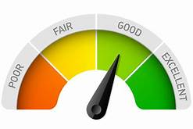
Evaluation
Did you gain knowledge about what stress is and how to reduce it on the job?
Did you develop new skills to manage external stressors?
Do you have a new attitude towards navigating through internal stress?
Notes:
image from https://blog.neongoldfish.com/website-design/website-features-to-avoid

